Slide 1

US 2016 Crashes data thorough analysis
Ahmed Abdallah, Hossam Rashad, Rana Amr, Salma Taha, Mohamed Hussein

Slide 2
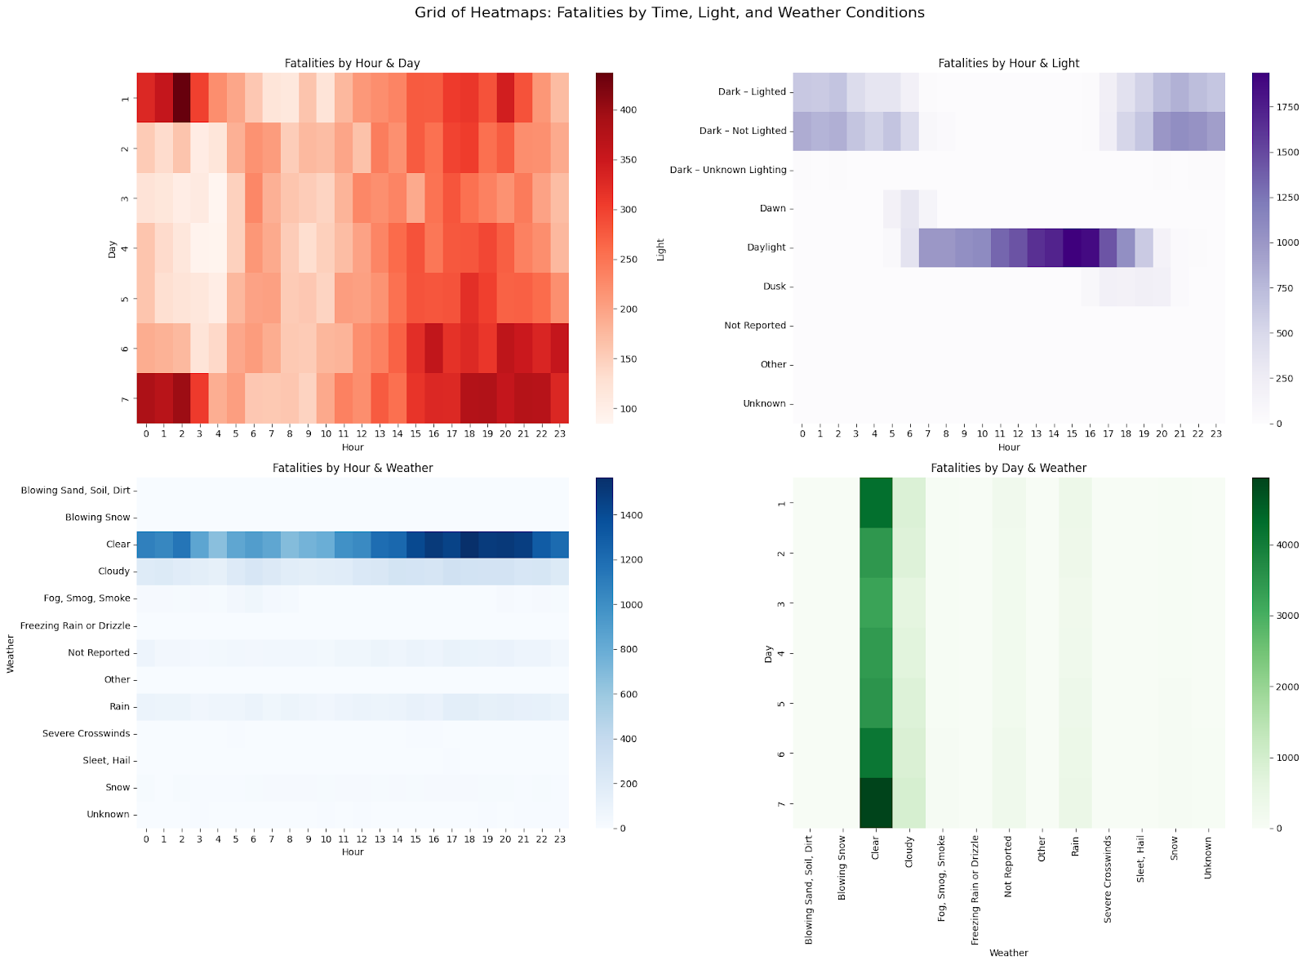
crashes to different weather and time conditions

Slide 3
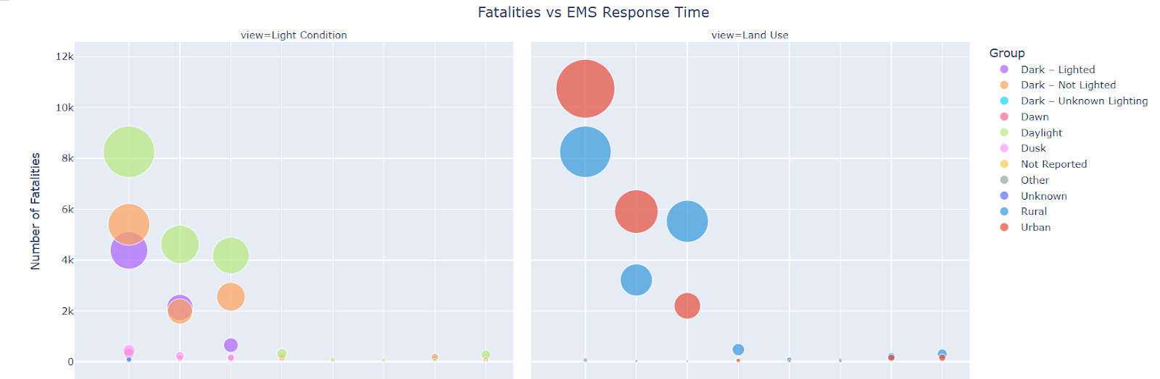
Fatalities vs. EMS Response Time by Urban–Rural Location & Lighting Conditions
Rapid EMS response (< 1 min) is associated with the lowest fatalities; delays beyond 9 min drive a sharp rise in deaths, especially in rural and poorly-lit areas

Slide 4
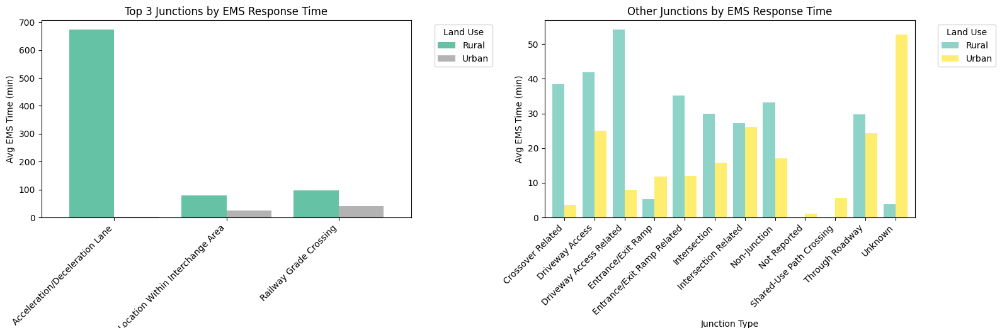
EMS Response Time Variation Across Junction Types by Land Use
Rural areas experience significantly higher EMS delays at specific junctions—especially acceleration/deceleration lanes—while urban areas generally maintain faster response times across most junction types.

Slide 5
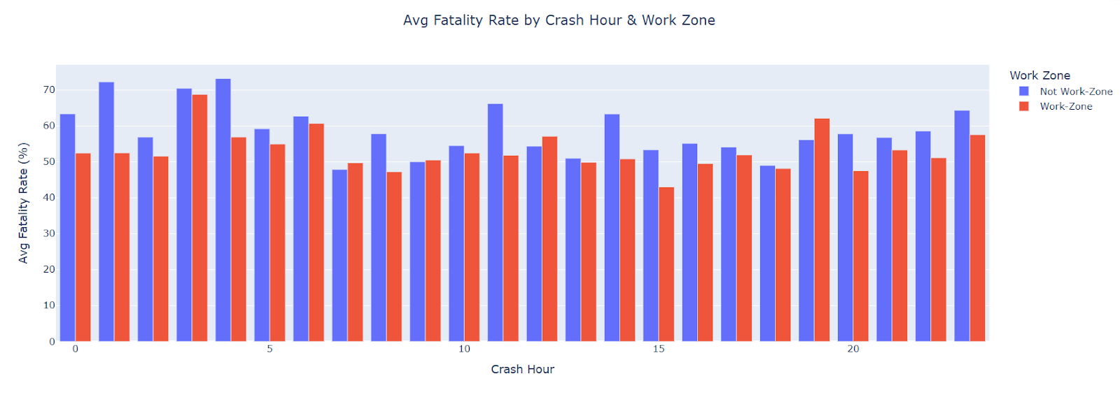
Fatality Rate by Crash Hour in Work Zones vs. Non-Work Zones
Fatality rates are consistently higher during late-night and early-morning hours, with non-work zones showing slightly elevated risk across most hours compared to work zones.

Slide 6
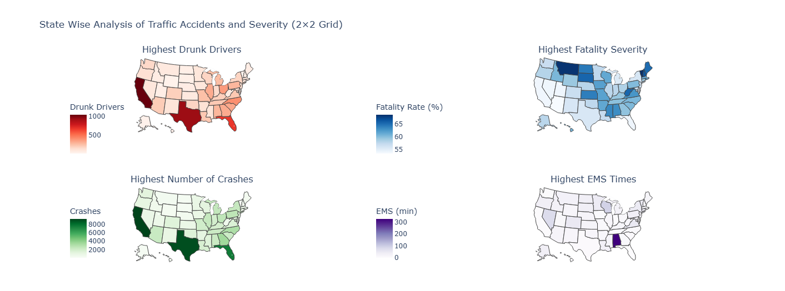
State-Level Disparities in Traffic Crashes and Severity Indicators

Slide 7
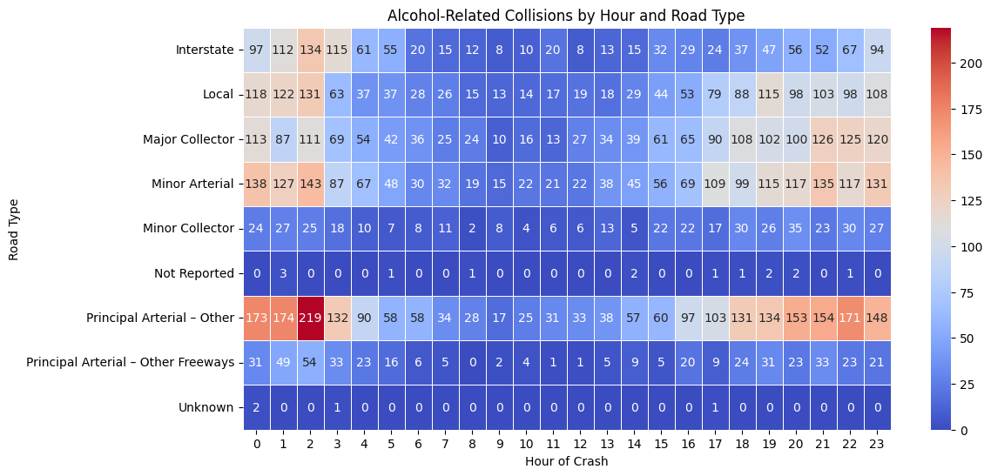
Alcohol-Related Collision Density by Road Type and Time of Day

Slide 8
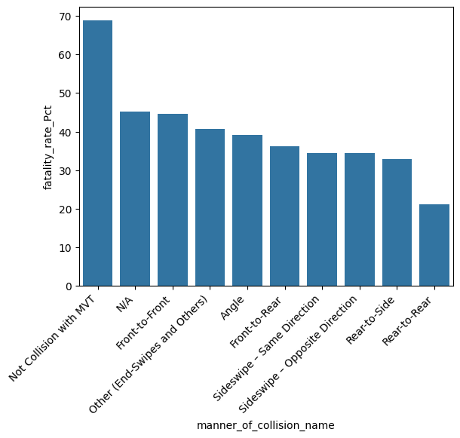
Crash Severity by Collision Type

Slide 9
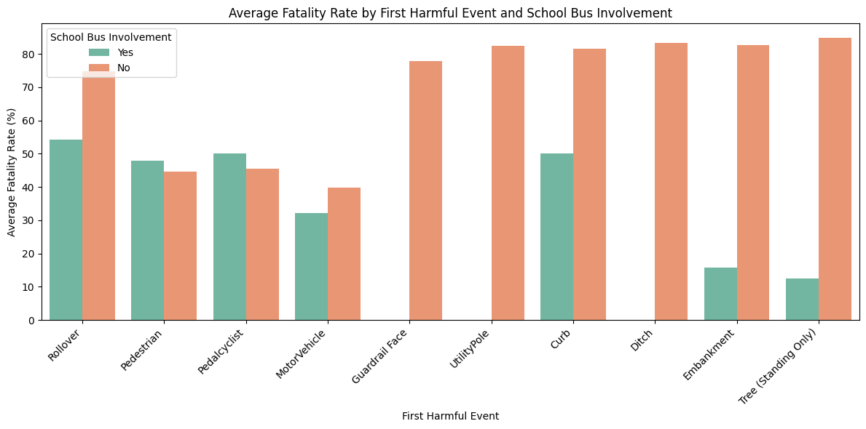
Fatality Rates by First Harmful Event and School Bus Involvement

Slide 10
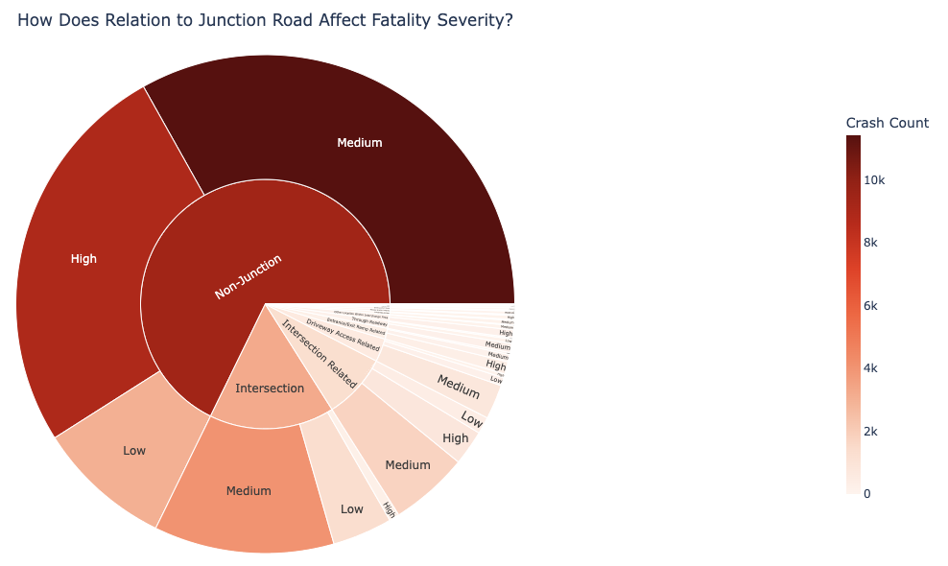
Fatality Severity by Relation to Junction Road
Most severe crashes occur away from junctions, with non-junction roads showing the highest crash counts at both medium and high severity levels—indicating a greater risk outside typical intersection zones.

Slide 11
Laws (ban) types affecting number of crashes

Slide 12
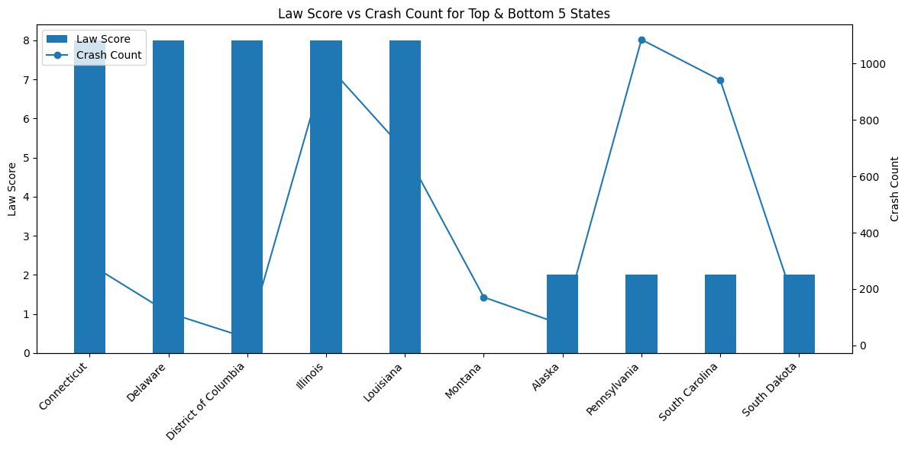
Law to crash for highest and lowest 5 states

Slide 13
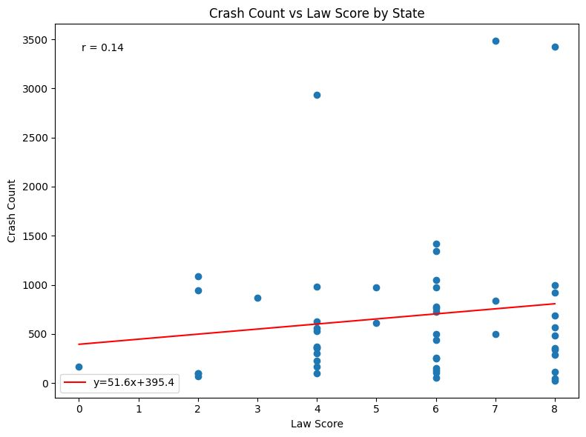
correlation of crashes to law strength

Slide 14
Holidays & nonholidays affect to crash

Slide 15
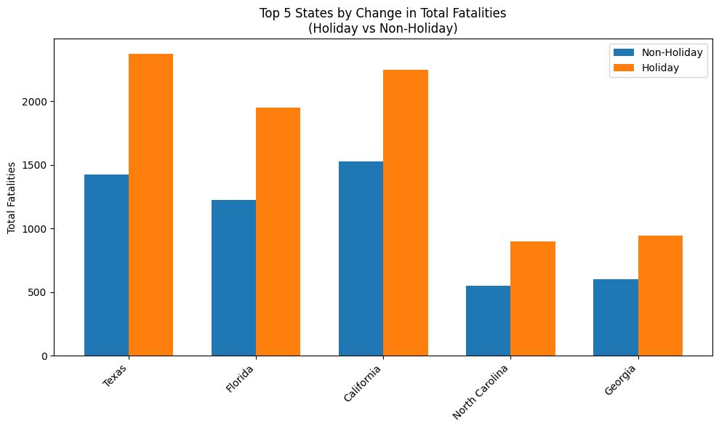
Total fatalities on holidays to non holidays in top 5 total fatality states

Slide 16
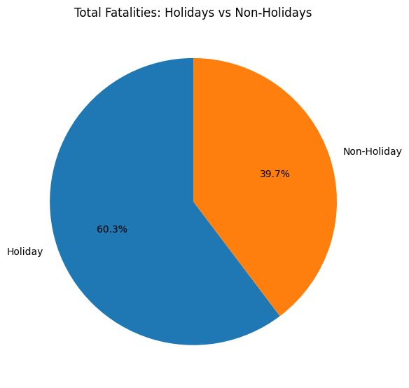
Percentage of fatalities on holidays and none holidays

Slide 17
Fatalities to gender - fatalities to age

Slide 18
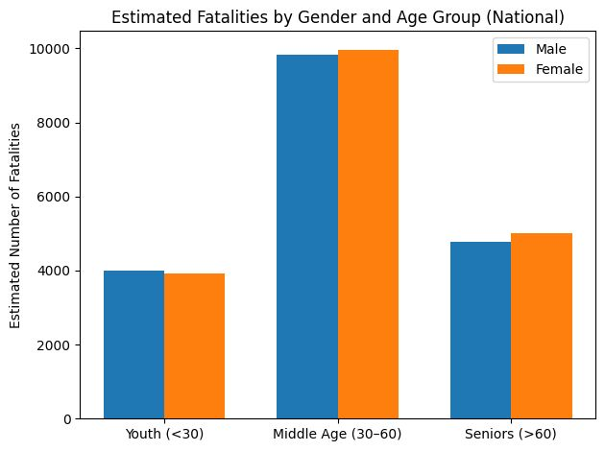
Age groups and gender fatality rate

Slide 19
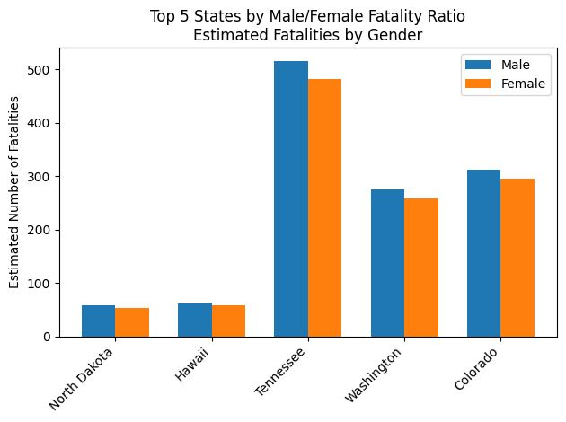
Gender-based fatality ratio in top 5 fatal rated states

Slide 20
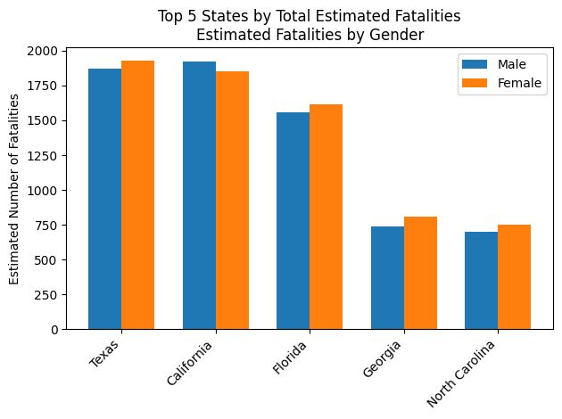
Total number of fatality to gender in top 5 states

Slide 21
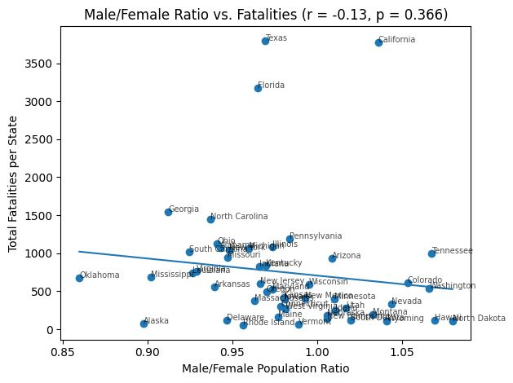
The ratio of male/female in fatality

Slide 22
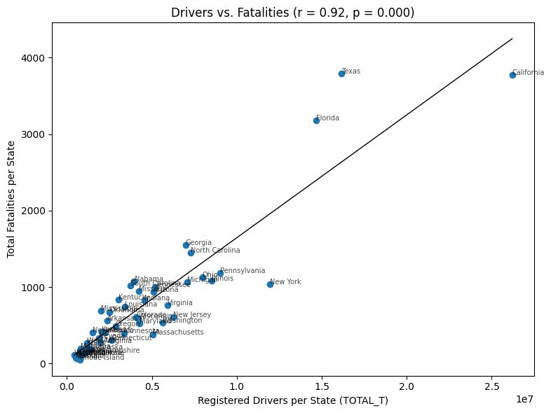
Regression of total driver count vs. fatality count

Slide 23
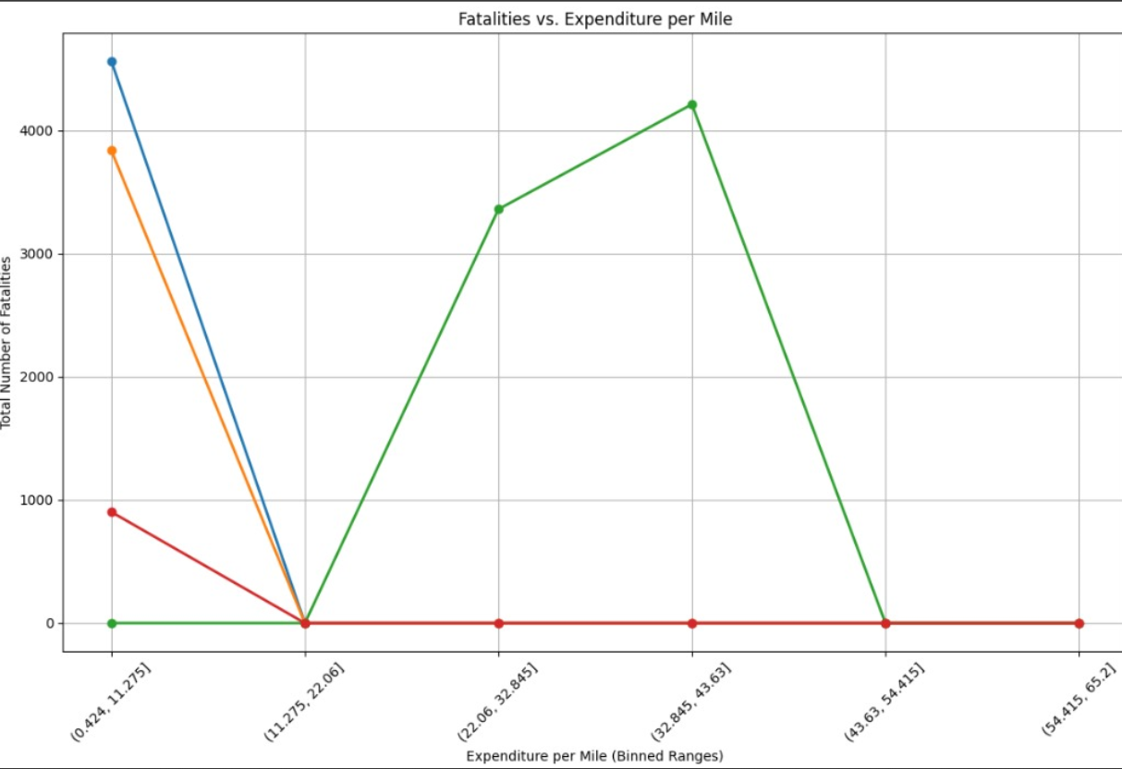
Expenditure per milage effect on the fatilities

Slide 24

Questions?

